Slide 1
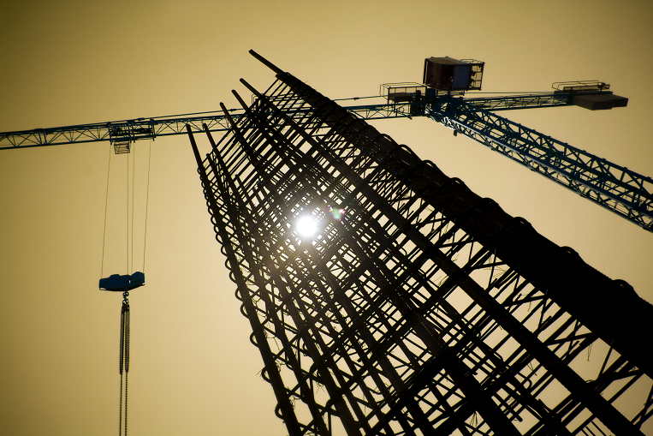

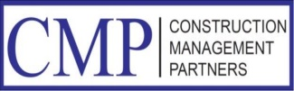
Managing the Solicitation Process
Construction Estimating
“The Devil is in the Details”
April 26, 2018
Bi-State Development Agency
Bi-State Development Agency
One Metropolitan Square
St. Louis, MO 63102

Slide 2
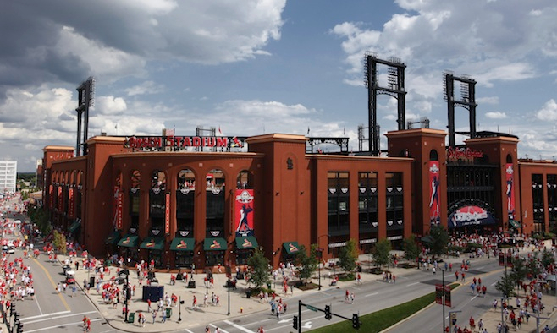
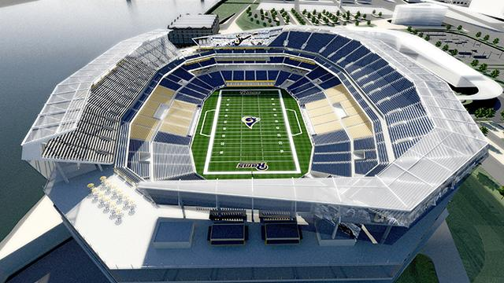
Success in Construction
Managing the Solicitation Process
Construction Managers
Presentation Outline
1. Introduction
2. Managing the Solicitation Process
3. Engaging in Winning Strategies
4. The Impact of a Good Estimate
5. Common Estimating and Bidding Mistakes
6. Conclusion
7. Questions & Answers

Slide 3
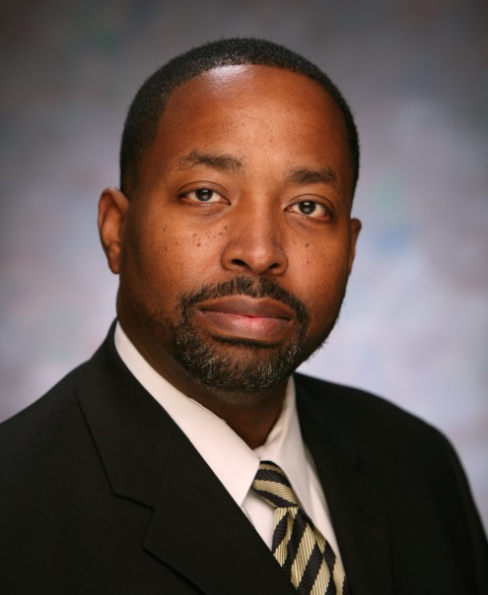

2018 Speaker Information
Marvin L. Johnson CCA, CCP
Senior Consultant-Member Owners Representative and Advisory Services
Missouri Baptist Medical Center
BJC HealthCare Campus Renewal Program
St. Louis Cardinals New Busch Stadium
St. Louis Riverfront Football Stadium
Miami Dolphins Sun Life Stadium
RELEVANT EXPERIENCE
32 years of construction management experience in local, regional and national design and construction markets.
Sr. Project Management and Executive Operations level expertise has contributed to managing, shaping and placement of over $1 Billion of construction.
Recipient of several (CNR) Construction News & Review Regional Excellence Awards for Construction Cost Effectiveness and Partnering Excellence.
$Billion Dollar Impact Program – Inaugural Year 2012
  St. Louis Minority Supplier Development Council
National Association of Construction Auditors
SERVICE EXPERTISE
Integrated Project Delivery (IPD)
Design-Build-Bridging (DBB)
Development of PMP (Project Management Plan)
Analysis - Speed to Market Strategies
Determination/Evaluation of Project Delivery Method
Project Incentives vs. Penalties
Evaluation of Project Insurance
Construction Audit Program
Strategies for Phased Delivery and Turn-over
Managing Jurisdictional Issues
PLA - Project Labor Agreement Review
Budget, Analysis and Cost Controls
(Pre-GMP, GMP, IGMP/OGMP)
Pre/Post-Bid Process Management
Delay Claim Analysis
Non-Compliance Analysis – Remedy
High level cost avoidance and Recovery

Slide 4
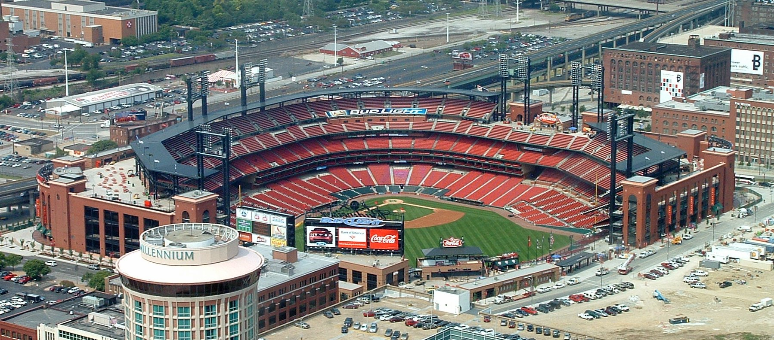
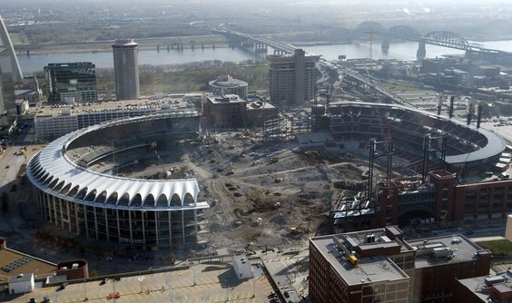
St. Louis Cardinals
New Busch Stadium Ballpark

Slide 5

St. Louis Riverfront Stadium Project
New NFL Football Stadium Facility

Slide 6

Missouri Baptist Medical Center New West Pavilion

Slide 7



Slide 8
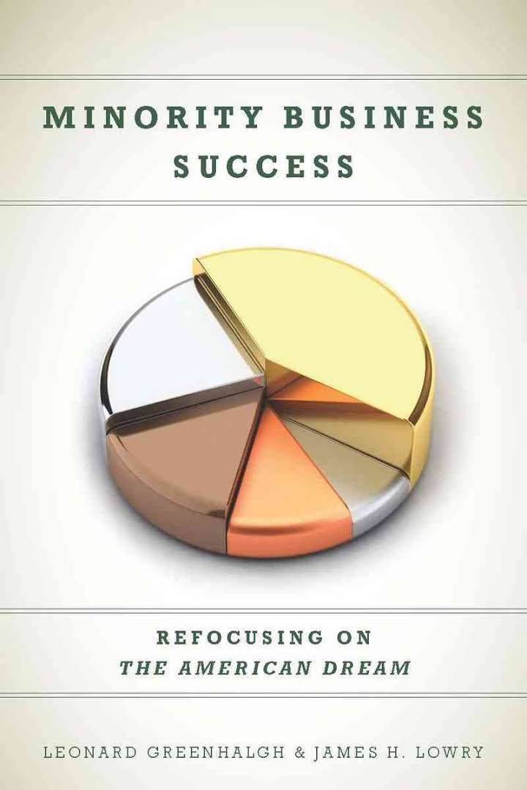
Minority Business Success Is a National Priority
To Succeed is to Survive, Prosper and Grow to Scale
Government Must refocus on Inclusion
Corporations Should refocus on Development, Not Procurement
Support Organizations Should refocus on Core Missions
Minority Business Success Requires Leadership, Direction and Vision
Vision:
The Ability to See What is Invisible to Others

Slide 9
Managing a Successful Bid Process
What is a Construction Cost Estimate?
A cost estimate is the approximation of the cost of a program, project, or operation. The cost estimate is the product of the cost estimating process. The cost estimate has a single total value and may have identifiable component values.
Site Work and Substructure
Shell – Superstructure
Interior – Core
Services – Primary/Secondary Equip/Utilities
Equipment and Furnishings – FFE
Special Construction
General Conditions

Slide 10
Managing a Successful Bid Process
What is a Construction Estimate?
Prediction of probable cost
Determining how to put the pieces together in the most economical manner
Estimating is both Art and Science
Identify and quantify the project components – Takeoffs
Read and Understand the Contract Documents
Ask Questions “Early” and “Often”

Slide 11
Managing a Successful Bid Process
Main Types of Construction Estimates
Order of Magnitude
Design Estimates or Pre GMP Level
  Schematic Level
  Design Development
  Construction Documents
100% CD Level or GMP Level
Post GMP Level Pricing

Slide 12
Managing a Successful Bid Process
Bidding vs. Estimating
Bidding
Submission and or response to a project solicitation for professional services
Assembly of a document which will include a scope, schedule, budget, management approach, etc.
Estimate
Exercise that establishes the cost to complete the requested scope of work
Identify cost of labor and materials
Establish risk, overhead & profit based on scope, schedule and complexity
Identify staff resources to deliver the project

Slide 13
Managing a Successful Bid Process
Where do we start ?
The Beginning
WHO, WHAT, WHEN AND HOW

Slide 14
The Impact of Early Decisions
Pre-Construction Planning
Construction Execution
Cost of
Construction
High
High
Ability
To
Influence
Cost
Conceptual Planning
Schematic / DD Phase
Construction
Close-Out
Project
Expenditure
Final Design
Phase
Procurement
Bid & Award
Cost Influence
Low
Low
Start
Time
Complete
Staying Ahead of the Curve
0

Slide 15
An Effective Pursuit
Know the market vs. where you exist within the market
  Response Time and Available Staff & Financial Resources
  Requisite Project Experience
  Type of Solicitation
  Winning Strategy
Industry Relationships
  How strong is your network?
  Market reliability and performance history
  Alliances and partnerships
  The Elevator Speech

Slide 16
An Effective Pursuit
Pursuit Intelligence - Hot Buttons
Can you engage in an effective pursuit?
Do you have the patience to work through the process?
Go-No-Go Criteria? Decision Points?

Slide 17
The Process - Bidding - Proposal
Request for Proposal – Request for Qualifications – Hard Bid Documents
  Read all of the documents
  Attend the Pre-Bid/Pre-Proposal Meeting
  Approach the opportunity from a position of knowledge
  Ask questions “Early and Often”
  Make a “Go – No Go” Corporate decision based on your predetermined logic, experience, risk tolerance, project complexity, identification of bidders, number of bidders, summary of your scope, availability of staff and your current project appetite
2. Preparation of the Proposal
  Clear understanding of your scope, exclusions and clarifications
  Read all the documents
  Identify your cost – Be Competitive
  Know What You Don’t Know – ask questions/get the correct answers/don’t guess
  Know your Overhead/Fee/Profit denominator – What do you need to be profitable?
  Contract Type – T&M, PSA, LS, GMP – Make sure you know the difference
  Complete all applicable forms
  Review it….Be Thorough……Correct your Math and Grammar
  Turn it in On-Time

Slide 18
The Process – Bidding - Proposal
3. Post Proposal Activities
  Scope review – Know what the Client is buying from you…….
  Be ready for an interview
  Don’t agree to perform services you did not propose – Don’t get caught up in the HYPE……
  Understand the schedule and performance expectations
    Delivery phasing, overtime, shift work, availability of equipment, buck hoist, site/building access, clean-up/composite crews, etc.
    Timing of construction start, LOI, contract, work authorizations, etc.
    Deliverables, Owner use-meetings, approval process, pull planning sessions
    Owner design review process, define all phases of design and budget
  RULES OF SURVIVAL
  Do not start any work or perform EXTRA WORK without a contract or the appropriate written authorizations/approvals

Slide 19
Managing a Successful Bid Process
So what information do estimators use to create an estimate? The following are key terms and concepts, but be aware that there’s a large degree of overlap between some of them.
Quantity Take-Off: Developed during the pre-construction phase, a quantity take-off measures the materials and labor needed to complete a project.
Labor Hour: The labor hour, or man hour, is a unit of work that measures the output of one person working for one hour.
Labor Rate: The labor rate is the amount per hour one pays to skilled craftsmen. This includes not just the basic hourly rate and benefits, but the added costs of overtime and payroll burdens, such as worker compensation and unemployment insurance. This template will help you keep track of wages and labor hours.

Slide 20
Managing a Successful Bid Process
Material Prices: Since the cost of materials is prone to fluctuation based on market conditions and such factors as seasonal variations, cost estimators may look at historical cost data and the various phases of the buying cycle when calculating expected material prices.
Equipment Costs: Equipment costs refer primarily to the cost of running, and possibly renting, heavy machinery such as cement mixers and cranes. It’s important to note that the equipment in use influences how quickly you can complete the project, so the use of equipment actually impacts many costs outside of those directly associated with running the equipment.
Subcontractor Quotes: Most contractors will hire multiple specialist subcontractors to complete parts of the construction. You add these subcontractors’ quotes to the contractor’s total estimate. (It can be helpful to use a tracker to collect all the subcontractor documentation in one place.)

Slide 21
Managing a Successful Bid Process
Indirect Costs: Indirect costs are expenses not directly associated with construction work, like administrative costs, transport costs, smaller types of equipment, temporary structures, design fees, legal fees, permits, and any number of other costs, depending on the particular project.
Profits: Of course, in order to make a profit, the contractor adds a margin on to the cost of completing the work. Subcontractors do the same when preparing their own quotes.
Contingencies: Since even the most accurate estimate is likely to be affected by unforeseeable factors, such as material wastage, an estimate will usually have a predetermined sum of money built in to account for such added costs.

Slide 22
Managing a Successful Bid Process
Dummy Job “A”
Material $200,000
Labor 20,000
Subcontractors 100,000
General Expenses 30,000
Subtotal #1 $350,000
Overhead @10% 35,000
Subtotal #2 $385,000
Profit @10% 38,500
Bid Amount $423,500

Slide 23

Mitigating the potential for failure:
Although the engineering and construction industry has made great strides in managing risk, 77% of respondents report underperforming projects, due primarily to delays, poor estimating and failed communication processes.
Source: KPMG International Global Construction Survey 2015

Slide 24

What Does Your Paper Say?
Lack of Transparency I Gaps in Interpretation I Failure to Effectively Communicate

Slide 25
Common Estimating Mistakes
Managing a Successful Bid Process
Misread or misinterpreted specifications, drawing, or any other contract document
Takeoff omissions or overlaps
Missing quotes from subcontractors and vendors
Estimating by unit price only
Using the percentage method to establish the cost of certain systems without validating cost with subcontractors
Crumbling under pressure to procure work – “High Risk Bidding”

Slide 26
Common Estimating Mistakes (cont.)
Managing a Successful Bid Process
Cutting prices to meet or beat someone else’s quote
Underestimating the complexity of a project
Relying on change orders to cover scope gaps
Undertaking a project with incomplete bid documents
Failure to ask questions

Slide 27
How to Improve your Estimating Procedure
Managing a Successful Bid Process
Internal labor rates and current material prices should be stored in your database.
Manual estimating is not cost effective and it is subject to errors and omissions.
Technology driven estimating is the standard.
Establish the company unit cost for labor with the appropriate mark-ups.
Establish an estimate review procedure. “War Room”

Slide 28

Management Accountability Critical Thinking Listen
Don’t Roll the Dice on Your Business

Slide 29
FOR EVERY ACTION THERE IS A REACTION
FOR EVERY CAUSE AN AFFECT

Slide 30
“ What you tell yourself you are you will be. “
“What you allow yourself to be, reflects who you have already told yourself you are. “
Iyanla Vanzant

Slide 31
“Chance Favors the Prepared Mind”
If you would like more information on creating strategies for successful project outcomes through effective Leadership, Project Management and Project Delivery, please contact me at:
Construction Management Partners, LLC
Marvin L. Johnson, CCA, CCP
5585 Pershing Avenue, Suite 101
St. Louis, Missouri 63112
314.454.9111.office
314.713.3429.cell
marvinjohnson@cmpstl.com
Linkedin.com
Visit us at cmpstlouis.com

